Slide 1


Slide 2


Slide 3
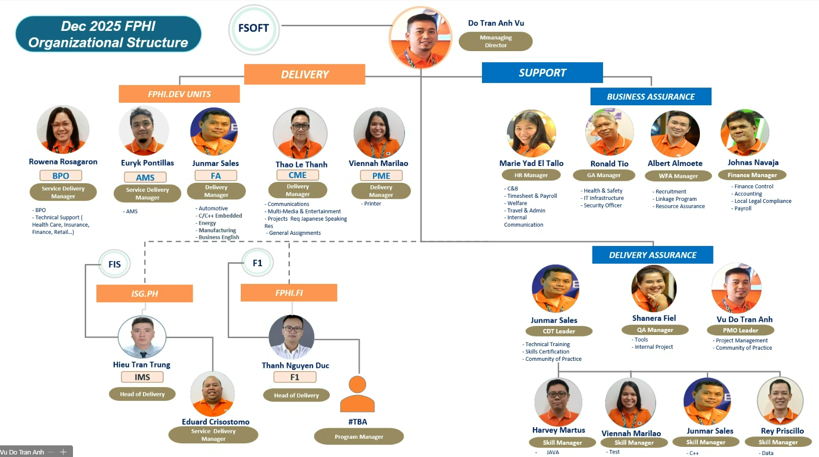

Slide 4


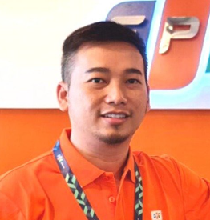
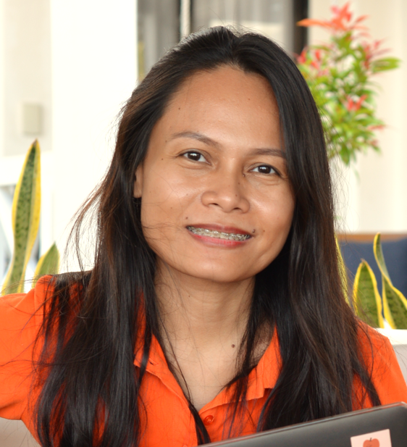
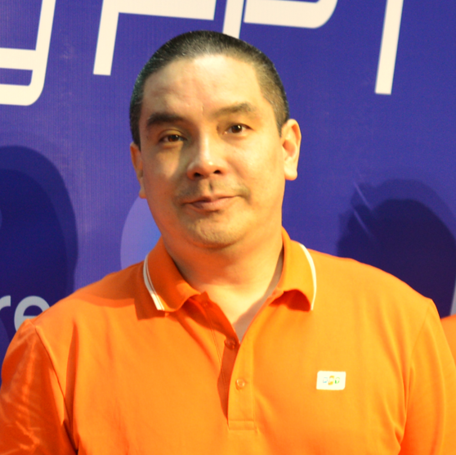
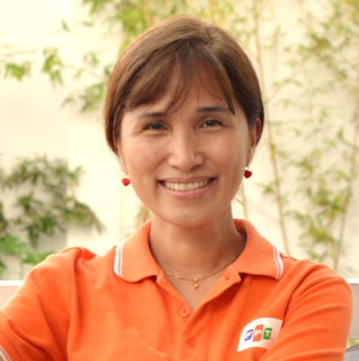
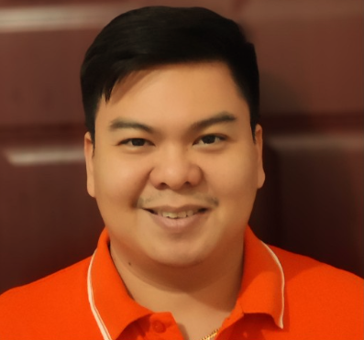

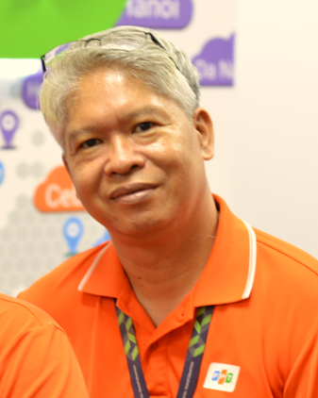
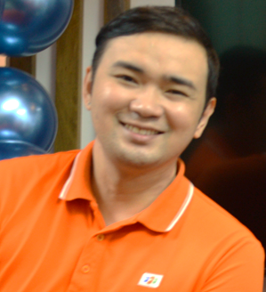
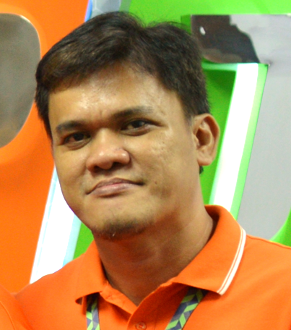
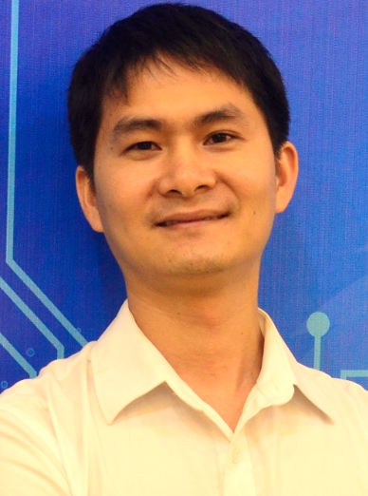
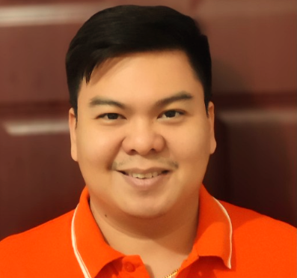

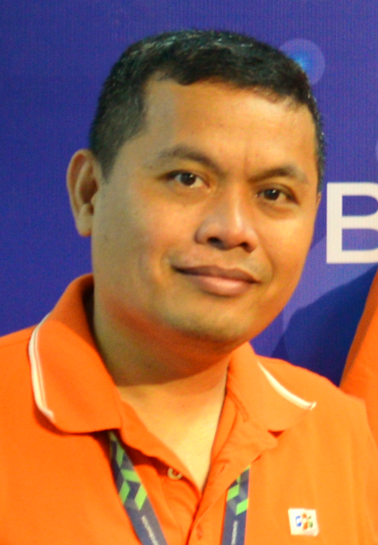

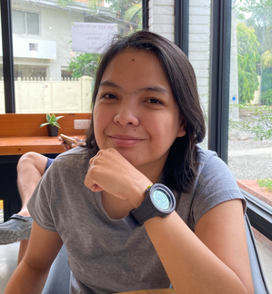

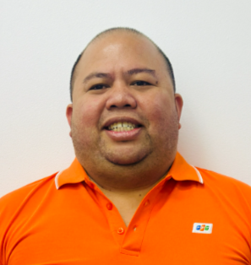
2024 FPHI Organizational Structure
FSOFT
DELIVERY
SUPPORT
FPHI.DEV
BUSINESS ASSURANCE
Albert Almoete
Johnas Navaja
<TBD>
Rhea Mae Tan
Jose Mari Paras
Grace Unson
Ed Brian Rieta
Marie Yad El Tallo
Ronald Tio
MS
AGA
CME
PME
HR Manager
GA Manager
WFA Manager
Finance Manager
Branding Manager
Service Delivery Manager
Delivery Manager
Delivery Manager
Delivery Manager
- C&B
- Timesheet & Payroll
- Welfare
- Facilities
- Procurement
- ISMS
- Recruitment
- Linkage Program
- Resource Assurance
- Finance Control
- Accounting
- Local Legal Compliance
- Payroll
- Marketing
- Community of Practice
- Customer Care
- External Communication
- Automotive
- General Assignment
- Hyper Automation
- Communications
- Multi-Media
- Entertainment
- Projects Req Japanese Speaking Res
- AMS
- BPO (Customer Support, Contact Center/Call Center, Technical Support)
- Printer
- Manufacturing
- Energy
- Travel & Admin
- Internal Communication
- Health & Safety
- IT Infrastructure
FA
FPHI.FA
DELIVERY ASSURANCE
Tran Thanh Binh
Ed Brian Rieta
Shanera Fiel
Vu Do Tran Anh
Head of Delivery
Junmar Sales
CDT Leader
QA Manager
PMO Leader
- Technical Training
- Skills Certification
- Community of Practice
- PQA
- SEPG
- ISO
- Tools
- Internal Project
- Project Management
- Community of Practice
Delivery Manager
FIS
FPHI.FIS
Jose Mari Paras
Harvey Martus
Viennah Marilao
Tran Trung Hieu
Skill Manager
Skill Manager
Skill Manager
Head of Delivery
Eduard Dela Torre
- .Net
- JAVA
- Manual Test
- Automation Test
- IMS
Service Delivery Manager

